Slide 1

EDUConnect
Low-Fi Prototype
Notes:
Throughout our research over the past few weeks, we noticed that there is a barrier between teachers and students can be daunting in high school.
We saw that positive relationships build better learning experiences and productive classroom environments.
We wanted to provide a mobile application called Educonnect that collects data on how a teacher and their students are feeling to suggest activities that help tailor the classroom experience to make students feel more understood and accounted for in the classroom.

Slide 2

Value proposition
Mission Statement
Understand, connect, and engage with your students.
Our goal is to help build positive student-teacher relationships to create a better high school learning experience.
Notes:
From that, we came up with the……..

Slide 3
overview
Selected Interface and reasoning
Task flows
Experimental methods
Results
Suggested ui changes
Notes:
I will start by going through the selected interface and its low-fi prototype structure.
Then, i will go through the task flows.
From there, the experimental methods and results.
And then the resulting suggested UI changes.

Slide 4
Selected Interface
Notes:
Jumping into this week’s expansion onto our mobile application idea, we will start with the selected interface

Slide 5
EMOJI EMOTIONS

Slide 6
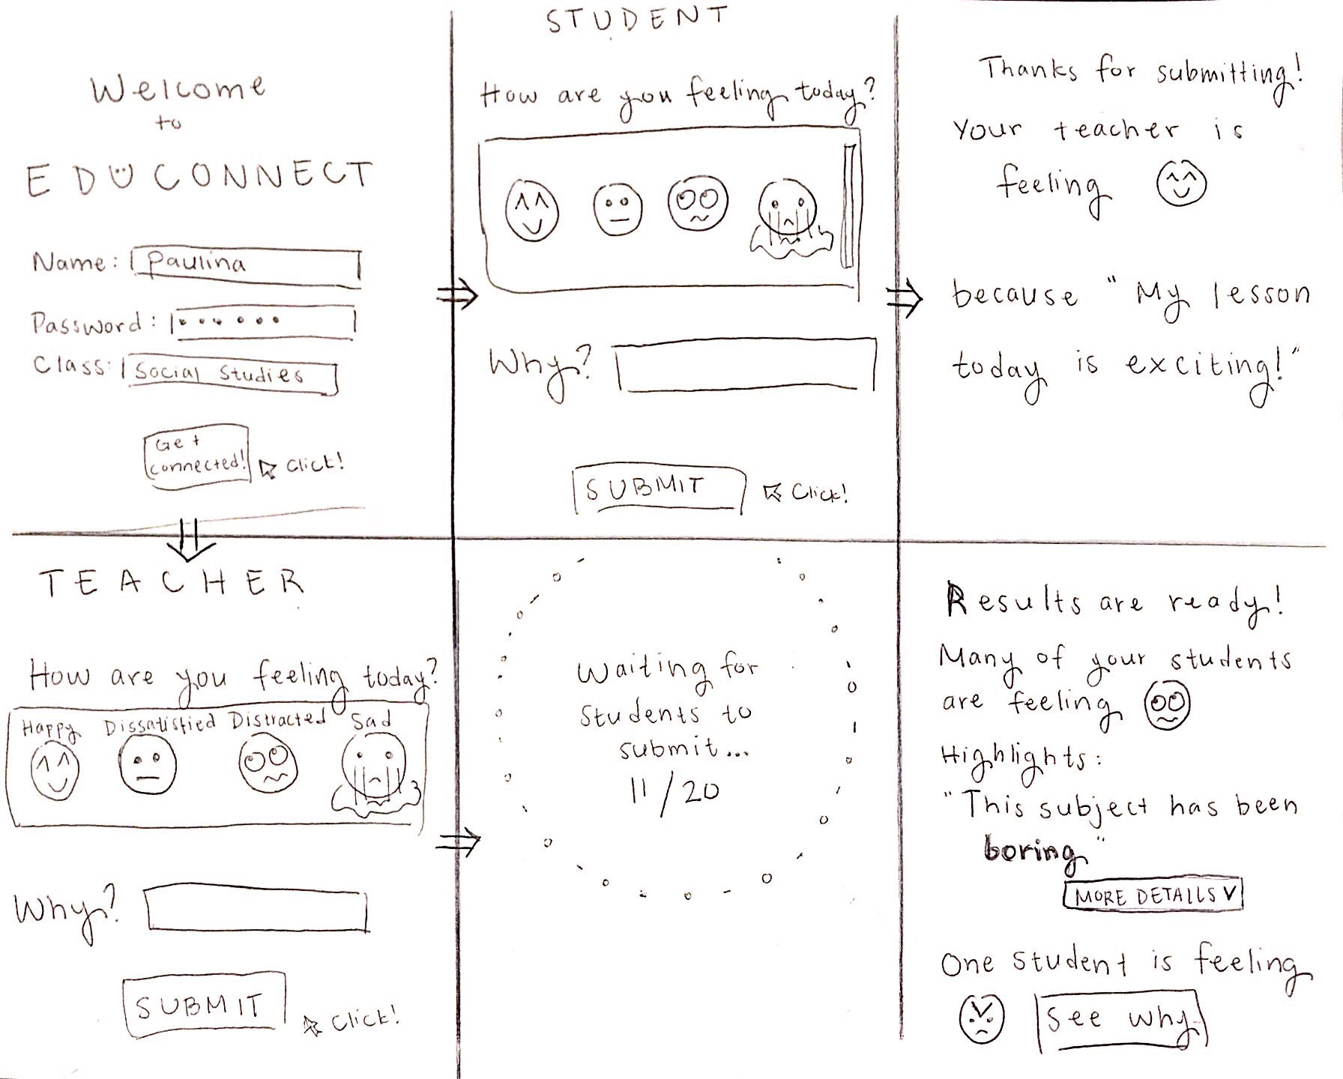
EMOJI EMOTIONS
Notes:
Start with a login screen to identify if the user is a student or teacher.
Next, the user is allowed to enter their emoji emotion for the day, regardless if they are a student or teacher.
From there, the student will see this screen, thanking them for submitting and showing them how their teacher is feeling. The teacher will be shown that they are waiting for all of their students to submit responses so the data can be synthesized.
After everyone submits, the teacher is shown the most occurring emoji emotion. They have the option to see more details (the students ‘why’ responses), and see if there are any students feeling notifiably different today.

Slide 7
EMOJI EMOTIONS
Notes:
Our reasons for selecting this were...

Slide 8
EMOJI EMOTIONS
Students can have fun choosing an emoji that represents how they’re feeling

Slide 9
EMOJI EMOTIONS
Students can have fun choosing an emoji that represents how they’re feeling
Easier for synthesizing data

Slide 10
EMOJI EMOTIONS
Students can have fun choosing an emoji that represents how they’re feeling
Easier for synthesizing data
Emojis are already available for use--for instance, do not have to type in a lot of emotion options

Slide 11
EMOJI EMOTIONS
Students can have fun choosing an emoji that represents how they’re feeling
Easier for synthesizing data
Emojis are already available for use--for instance, do not have to type in a lot of emotion options
No potential for inappropriate answers - more control

Slide 12
EMOJI EMOTIONS
Students can have fun choosing an emoji that represents how they’re feeling
Easier for synthesizing data
Emojis are already available for use--for instance, do not have to type in a lot of emotion options
No potential for inappropriate answers - more control
Notes:
Based off of the above reasoning, as well as our pros and cons for each design, we decided to choose the Emoji Feeling Prototype. Overall, we felt that the option for teachers and students to choose how they want to express themselves would allow for the most natural communication. After discussing, we determined that both of our top designs would have the risk of not being taken seriously by the students, so that could not be an incriminating con of one design over the other.

Slide 13
Task Flow #1
Invite teachers and students to share how they’re feeling when class starts. (simple)
Notes:
Moving onto our task flows….

Slide 14
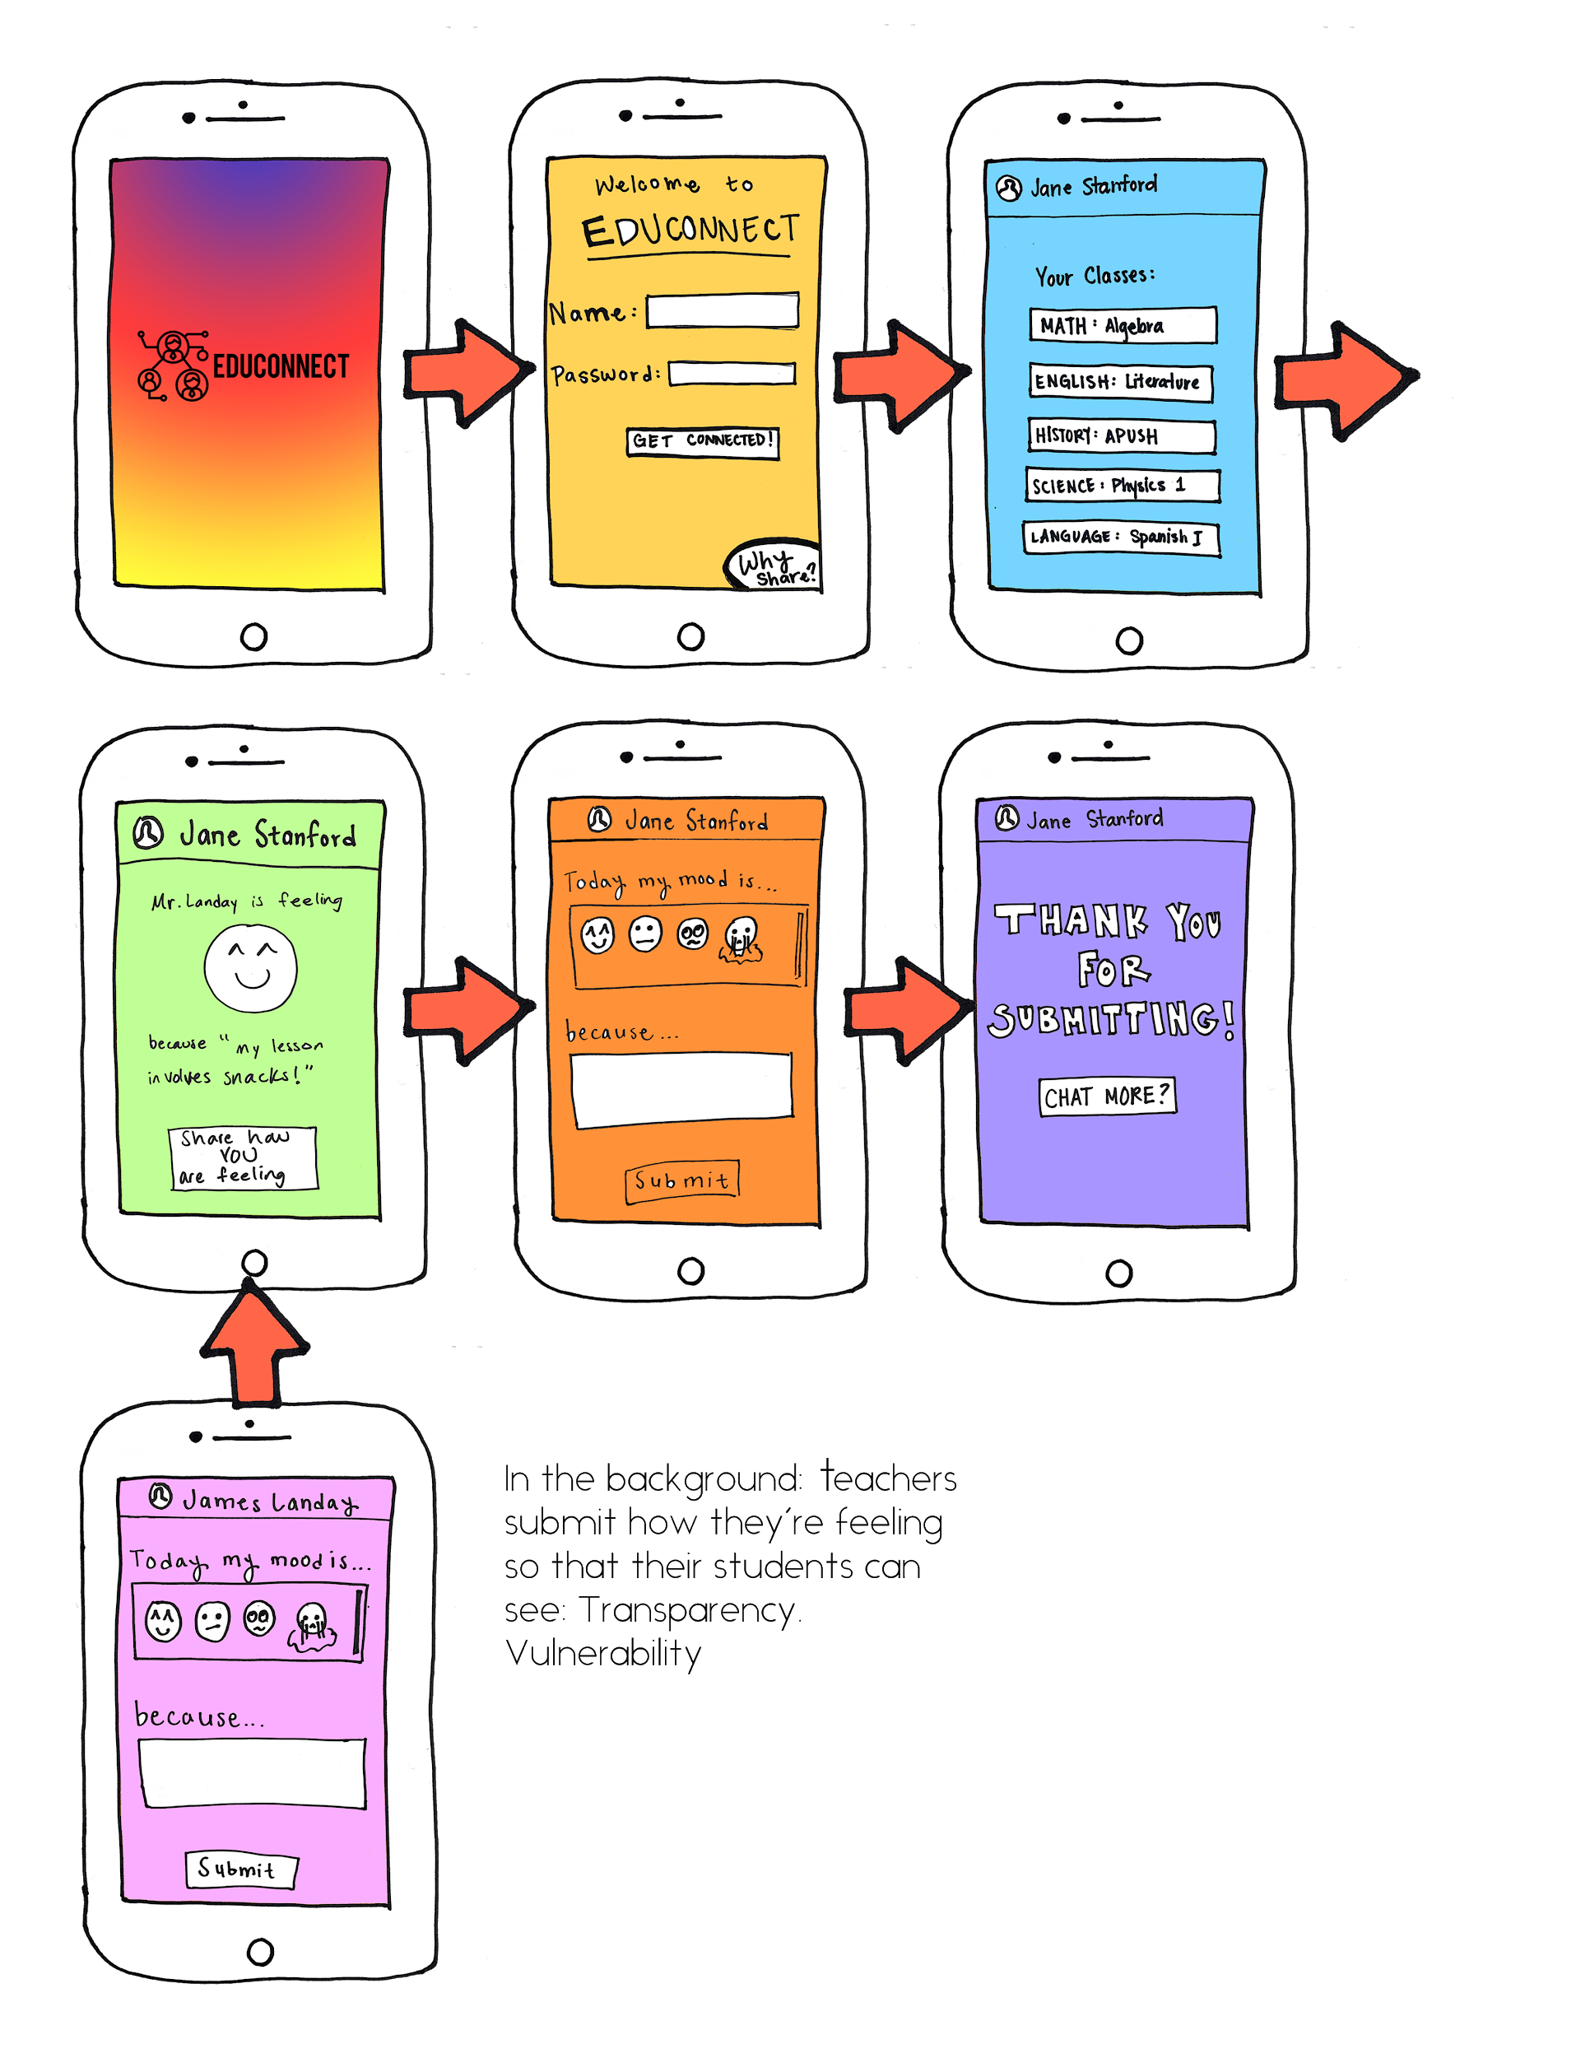
Task Flow #1: Invite teachers and students to share how they’re feeling when class starts. (simple)
Notes:
Here, we expanded on the original selected interface drawing and after further discussion, we decided that it would be best for the student to see how their teacher is feeling after selecting on the class before submitting their response. We felt that this would better invite students to be more vulnerable and accurately input their emotion for the day.
So, in the background (or before class begins), the teacher will have submitted their response so that their students can see this before they submit theirs.

Slide 15
Task Flow #2
Collect and synthesize feedback from students and teachers in order to tailor the classroom experience. (moderate)

Slide 16
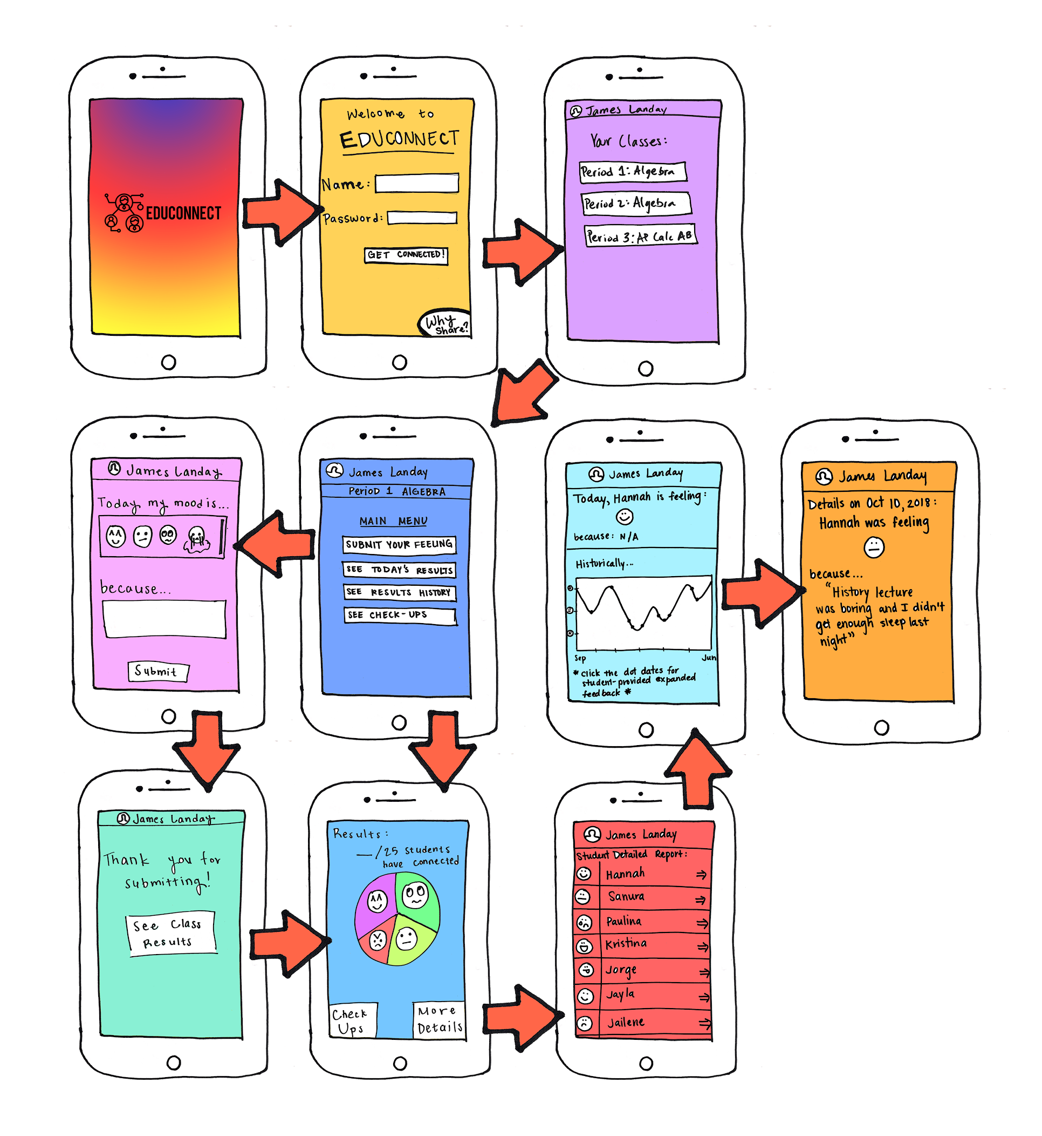
Task Flow #2: Collect and synthesize feedback from students and teachers in order to tailor the classroom experience. (moderate)
Notes:
Throughout the app, data is collected and synthesized. This synthesis is displayed in many ways. One way is that after the students have submitted, the teacher can see everyone’s responses here in the pie chart. They can click more details to go to this screen and see each students individual emotion. The teacher can click the arrow here to go to this page where they will see the student’s emoji emotion and reasoning along with their emotional history throughout the class.
The student’s navigation ends after submission.

Slide 17
Task Flow #3
Identify outliers who might want/need extra attention. (complex)

Slide 18
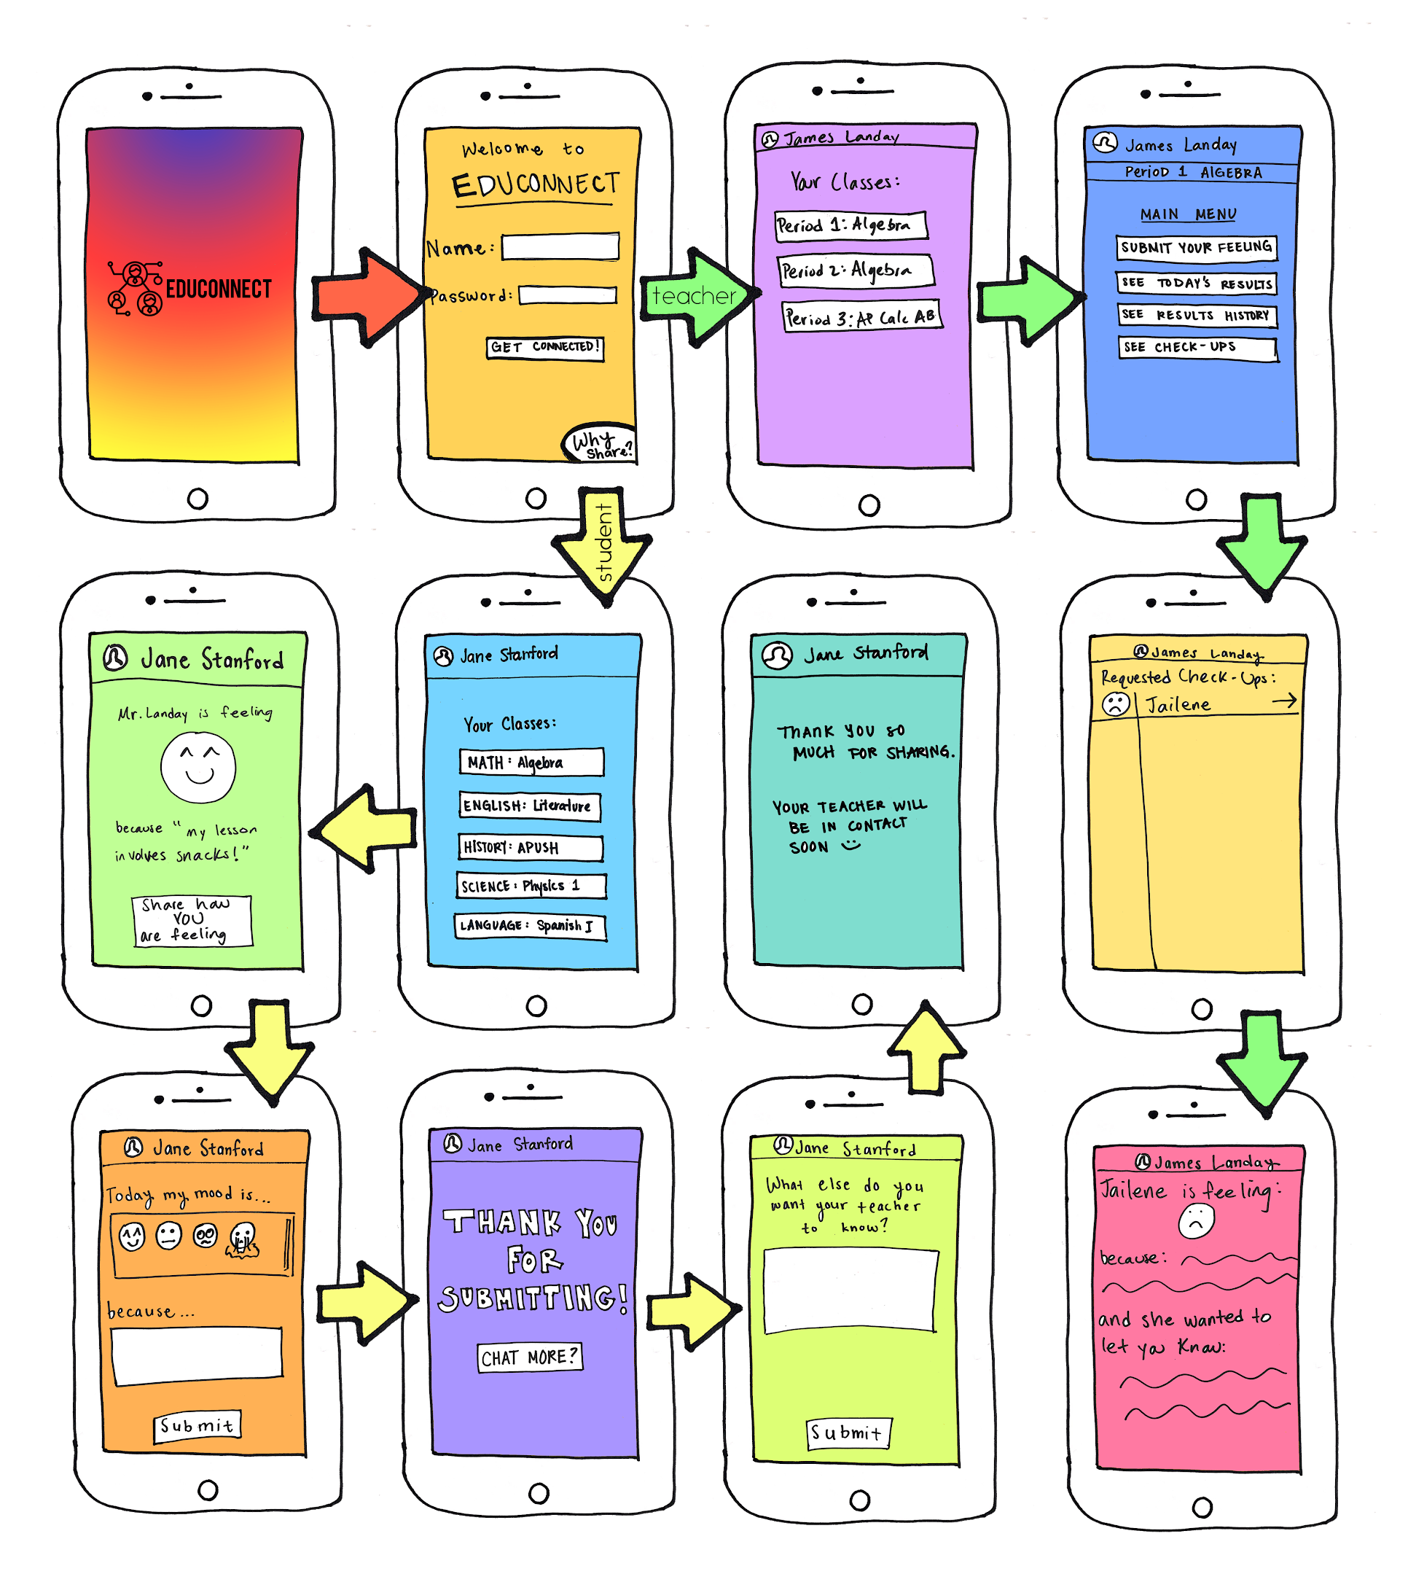
Task Flow #3: Identify outliers who might want/need extra attention. (complex)
Notes:
The main way that we decided to show this task is through an option for the students to “chat more” with their teacher outside of class. SO, go through these screens that we’ve already looked at. and when the student submits, they can click “chat more” and will be given the option to elaborate more on what they’re feeling and why for their teacher to see.
The teacher can see this if they click on “see check ups” from their main menu. They can click the arrow to view more information on this student’s emotion for the day. We were thinking that the teacher could then be responsible for maybe checking in on the student either during down time or after class.

Slide 19
Experimental method

Slide 20
The participants
Participant 1
5 years of teaching experience in middle school math
Currently a PhD student at the Stanford Graduate School of Education
Testing conducted at Coupa Cafe.

Slide 21
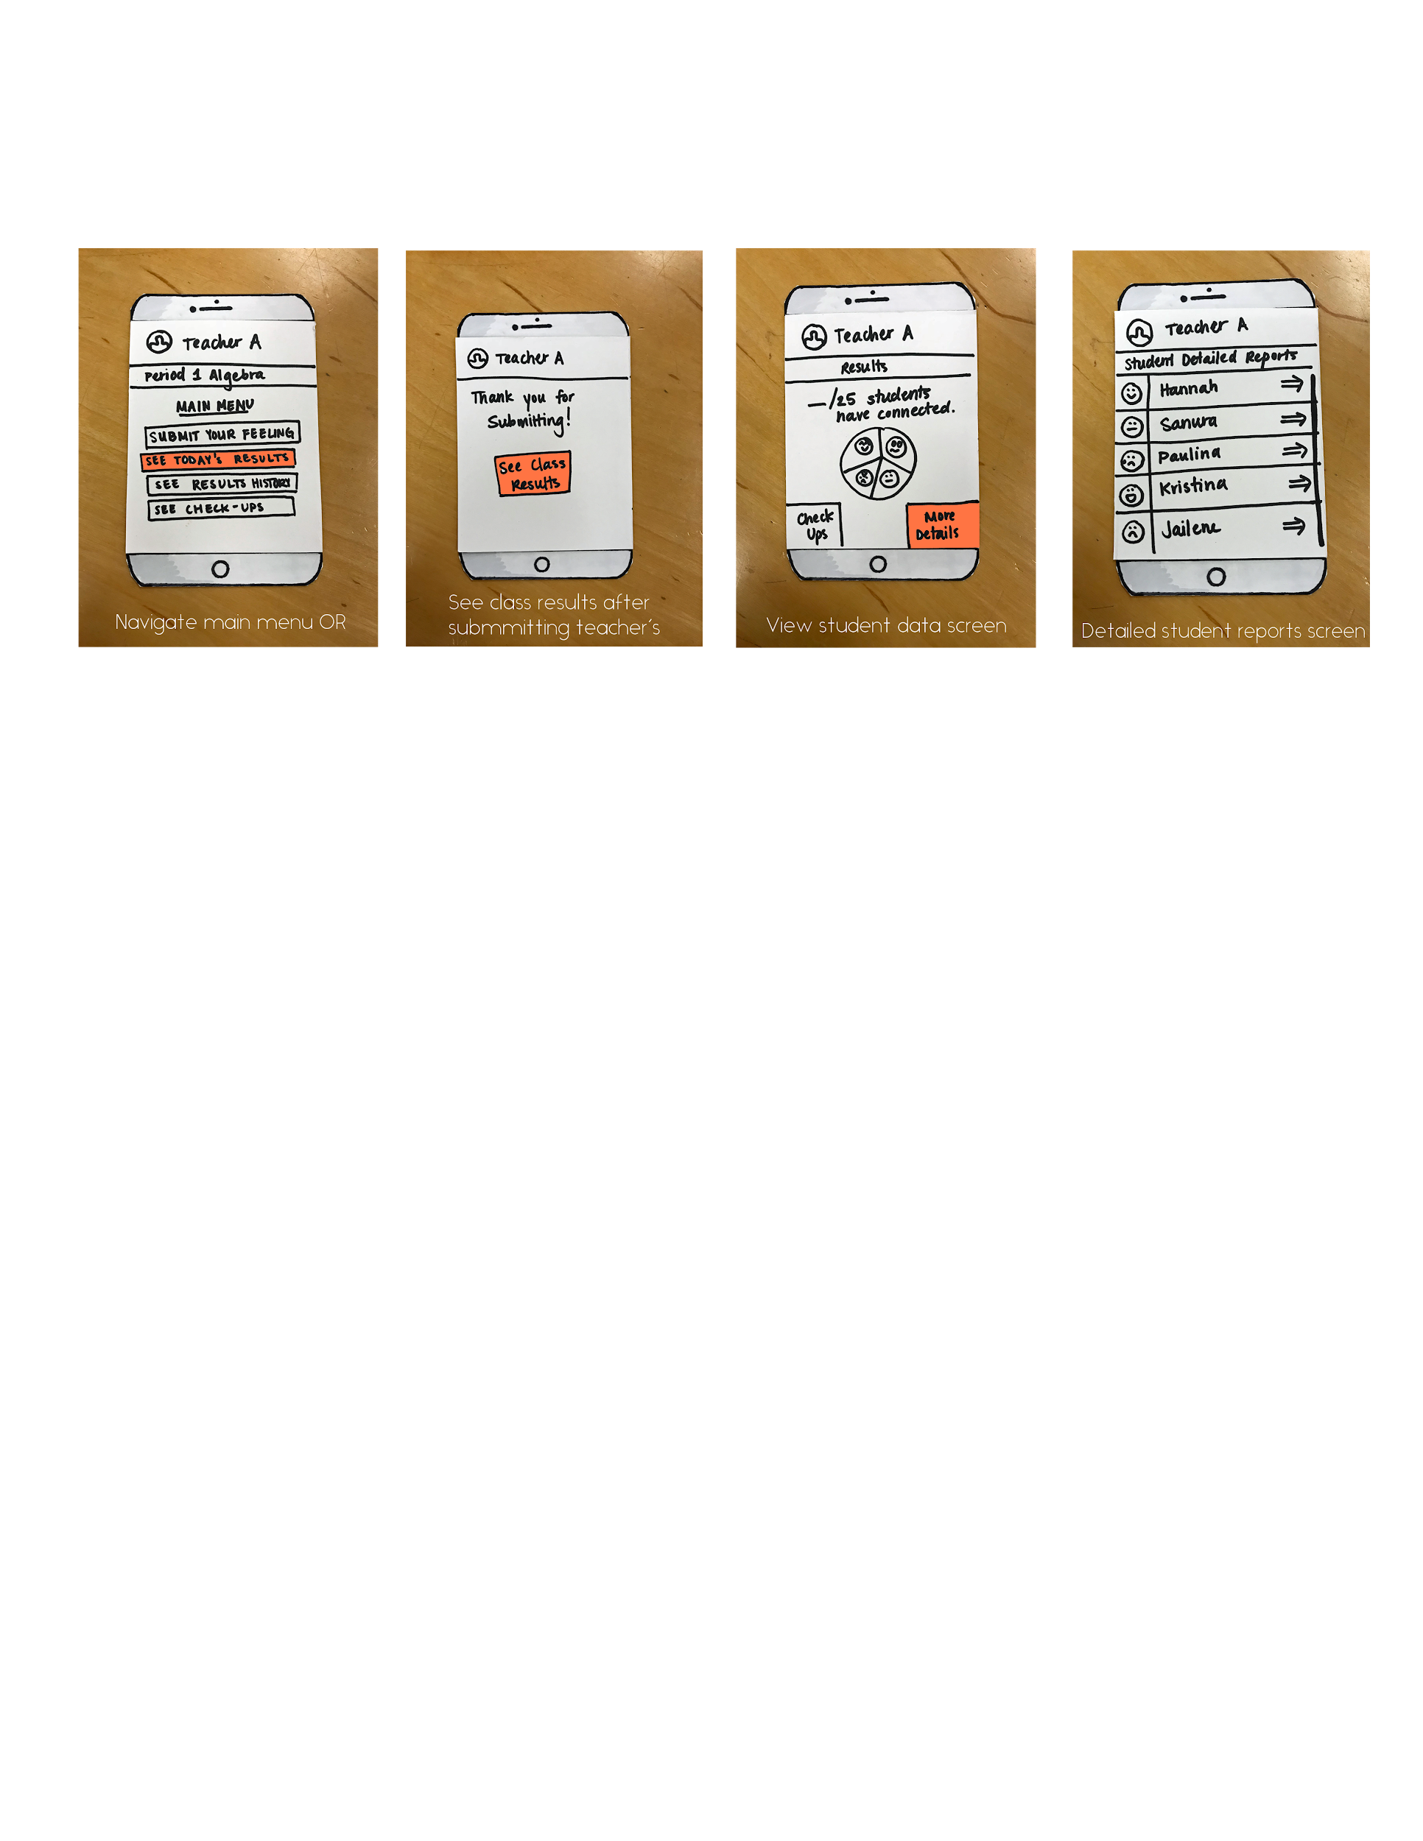
Participant 1
Results
Very easy, clean, and straightforward design to use
Students should not see the teacher’s response first
Would prefer to be given options of how to display the student results
Notes:
2. We originally thought that it would help the student open up more. However, participant 1 felt it would Influence the student’s response. For instance, if teacher is feeling overwhelmed, the student might not feel open to sharing that they are sad because they do not want to bare them with more problems.
3. Like the pie chart, but….

Slide 22
The participants
Participant 1
5 years of teaching experience in middle school math
Currently a PhD student at the Stanford Graduate School of Education
Testing conducted at Coupa Cafe.
Participant 2
high school student in the area
Testing conducted in a dorm lounge on campus
Compensated with a Starbucks gift card.

Slide 23
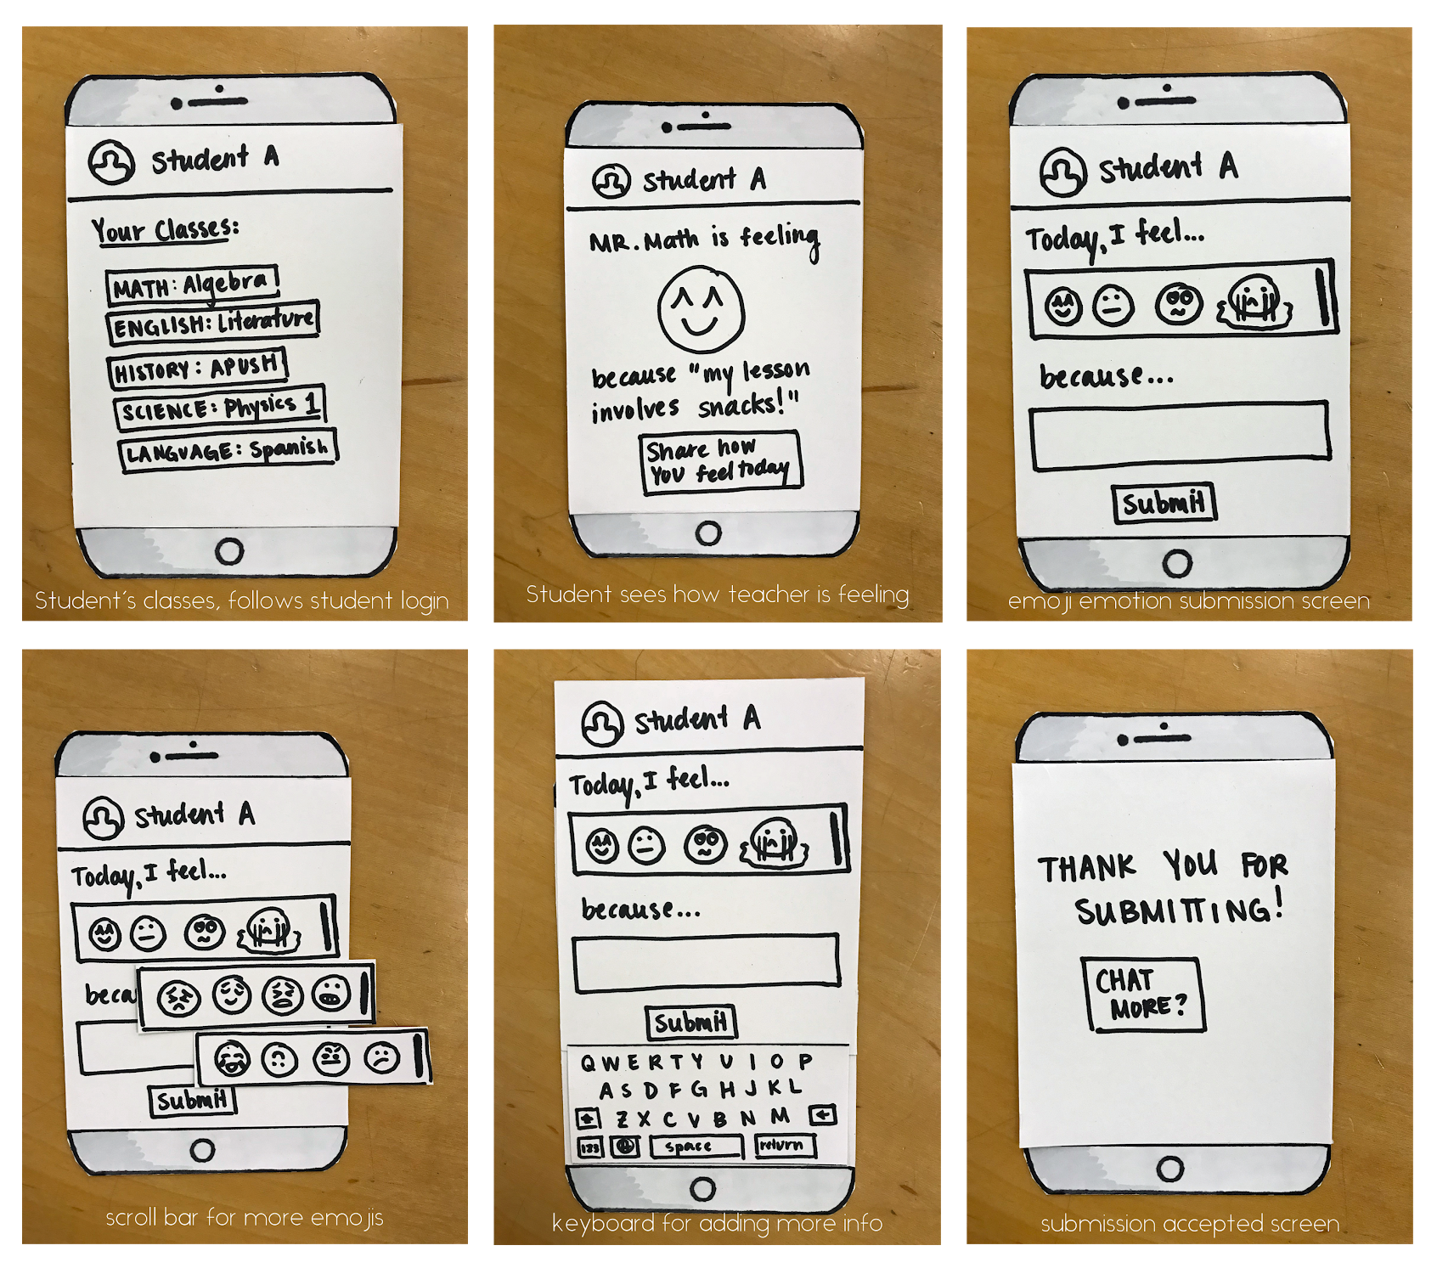
Participant 2
Results
Likes seeing how teacher is feeling
Confused on what happened completing survey and not sharing more
Wants teacher to complete survey simultaneously along with the students
Notes:
Feels comfortable being open about her feelings since the teacher was open
“Is the main page “Your Classes”? How do I go back to that?”
Would feel like a more natural communication process

Slide 24
The participants
Participant 1
5 years of teaching experience in middle school math
Currently a PhD student at the Stanford Graduate School of Education
Testing conducted at Coupa Cafe.
Participant 2
high school student in the area
Testing conducted in a dorm lounge on campus
Compensated with a Starbucks gift card.
Participant 3
current high school teacher
Found their email on the high school’s website.
Testing conducted at Tresidder

Slide 25
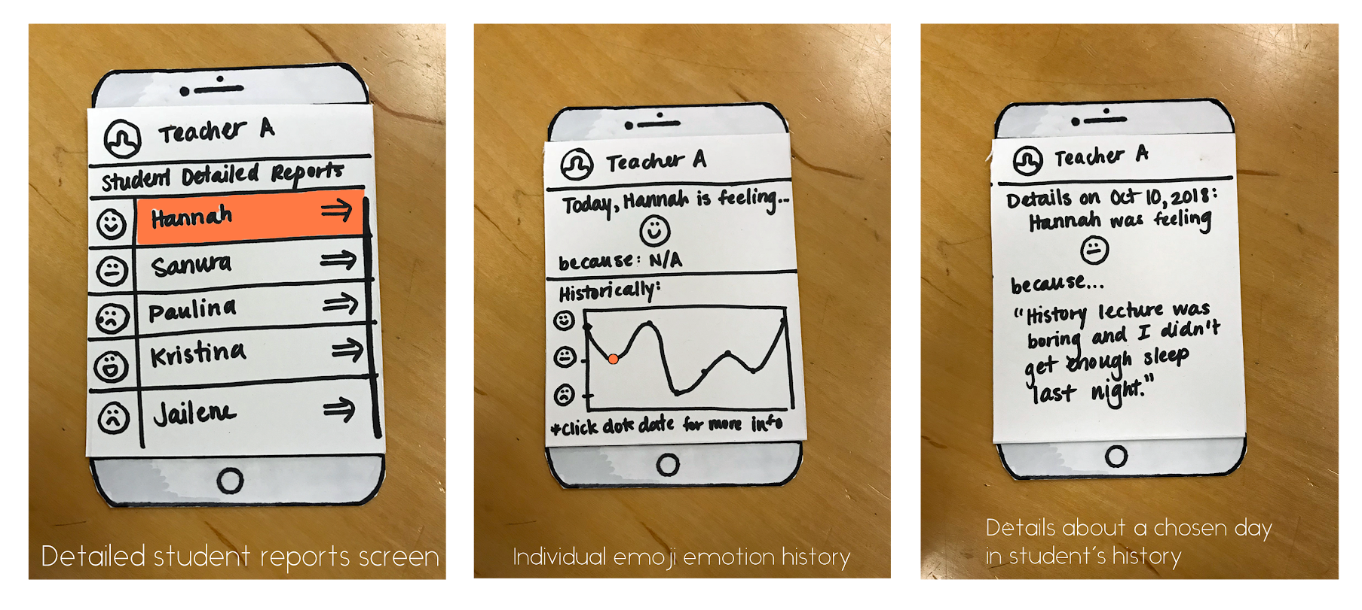
Participant 3
Results
Appreciated the ability to see the response history of students
Wants to see the students who chose each emoji from pie chart
Wants a chat system to reply to student responses

Slide 26
SUGGESTED UI CHANGES
Teacher and students complete responses simultaneously
Add menu/home button
Give teachers different options for how to view synthesized data
Considering:
Adding messaging system
Showing personal result history to students
Notes:
Based on student and teacher 1’s results. Then when teacher is finished, the student would see their response after they submit theirs

Slide 27
SUGGESTED UI CHANGES
Teacher and students complete responses simultaneously
Add menu/home button
Notes:
Based on student and teacher 1’s results. Then when teacher is finished, the student would see their response after they submit theirs

Slide 28
SUGGESTED UI CHANGES
Teacher and students complete responses simultaneously
Add menu/home button
Give teachers different options for how to view synthesized data
Notes:
Based on student and teacher 1’s results. Then when teacher is finished, the student would see their response after they submit theirs

Slide 29
SUGGESTED UI CHANGES
Teacher and students complete responses simultaneously
Add menu/home button
Give teachers different options for how to view synthesized data
Considering:
Adding messaging system
Showing personal result history to students
Notes:
Based on student and teacher 1’s results. Then when teacher is finished, the student would see their response after they submit theirs
Considering--need further discussion and weigh pros and cons

Slide 30
summary
UI overall clean and easy to follow
Teacher and Student appreciate seeing emotions
Keep student and teacher honest and engaged
Allow app to be more customizable for teachers
Needs home/menu button for better navigation
Considering more student engagement with app
Notes:
3. Teacher and student should complete at same time
4. Multiple options for data synthesis display
6. Adding messaging and personal history for the student to see because right now they only input their data and then they are done.

Slide 31

THANK YOU.
Questions?

